Slide 1
The third wave of IT systems
Tomasz Waszczyk
Konferencja Blockchain i Finanse
January 17th, 2020 Warszawa

Slide 2
Introduction - Tomasz Waszczyk
Software engineer
Ex trader Tier 1
Psychology (psychometrics, transactional psychology)
History
The presentation has no bias!

Slide 3
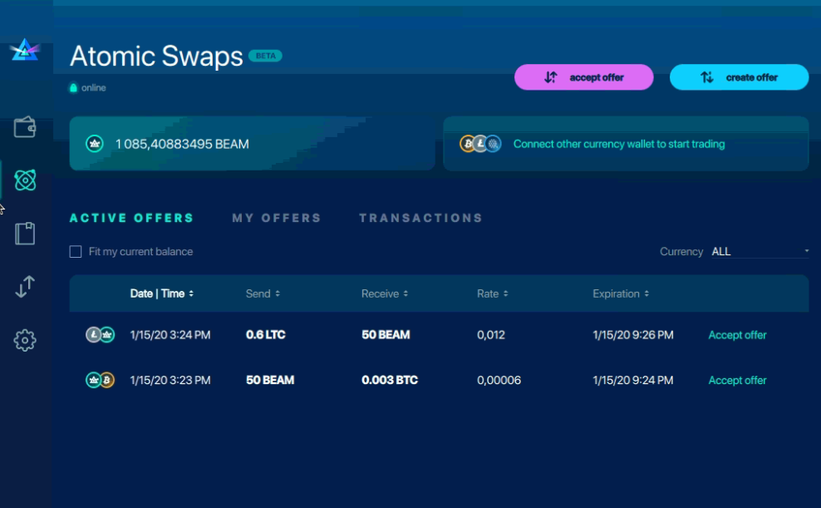
BEAM - Atomic Swap

Slide 4
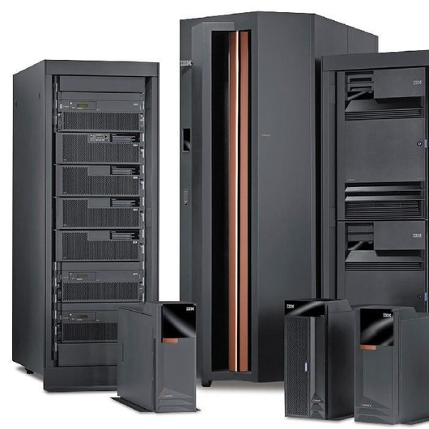
First wave

Slide 5
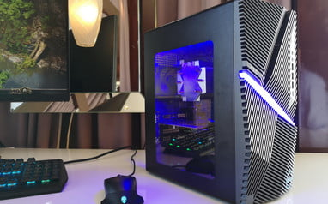
Second wave

Slide 6
What does third wave mean?
Easier entry to the marker together with big players
Strategic industries:
Food
Drugs, medicine
Insurance
Reinsurance
Strong need to cooperate with politicians (law)…

Slide 7
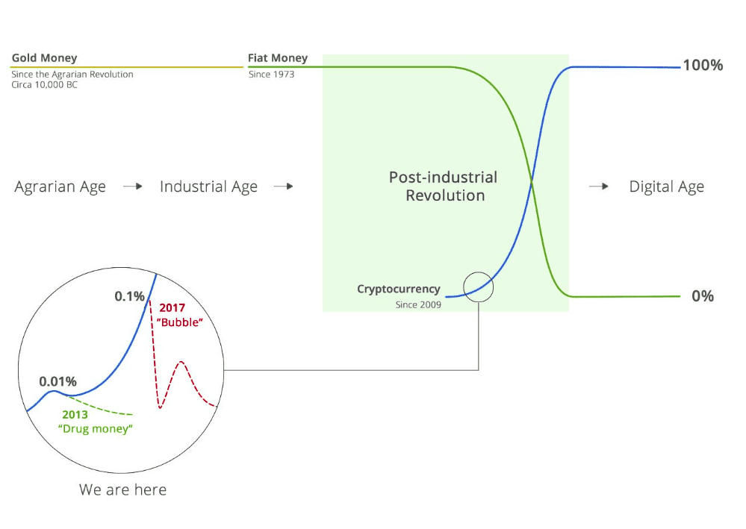
Third wave (in terms of technology and money)

Slide 8
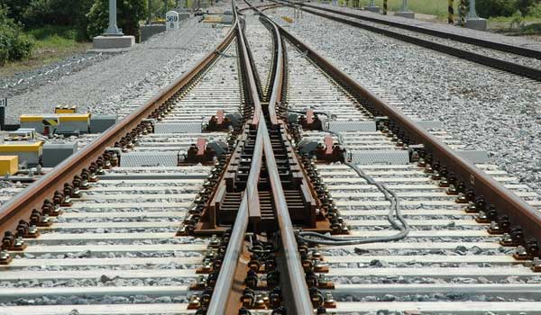
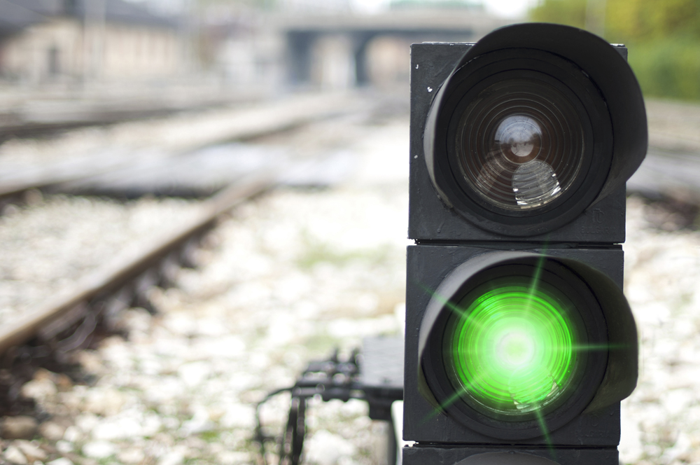
Use case 1 - transformation of predictive software

Slide 9
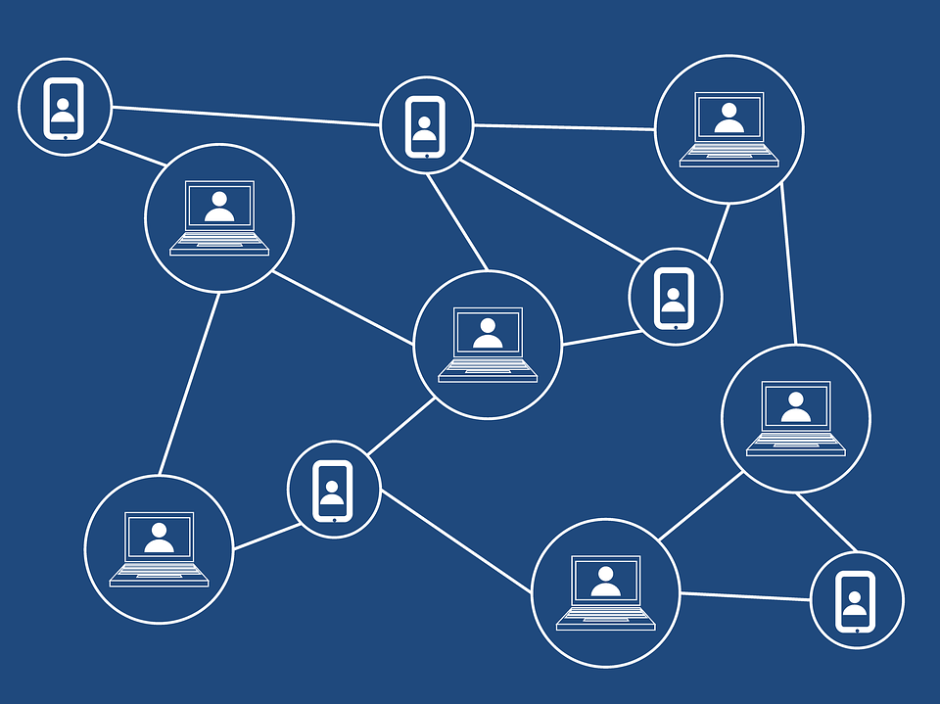
Use case 2 - reinsurance

Slide 10
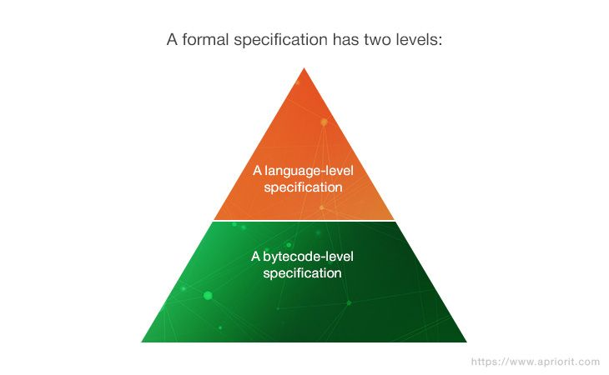
Common issue - formal verification - (not easy!)!

Slide 11
Formal verification - (not easy!) - Ethereum
EVM Level
Solidity Level

Slide 12
EVM verification challenges
“Verifying the EVM bytecode is challenging, especially due to the internal byte-manipulation operations that require non-linear integer arithmetic reasoning, which is undecidable in general.”
“The EVM provides three types of storage structures: a local memory, a local stack, and the global storage. Of these, only the local memory is byte-addressable (i.e., represented as an array of bytes), while the others are word-addressable(i.e., each represented as an array of 32-byte words).”

Slide 13
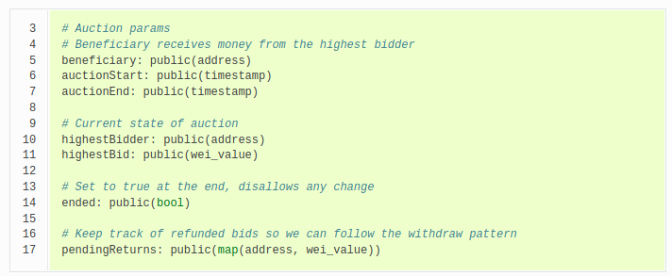
Vyper (SmartPy in XTZ) as a solution?

Slide 14
K framework as a solution?
“rewrite-based executable semantic framework in which programming languages, type systems and formal analysis tools can be defined using configurations, computations and rules. Configurations organize the state in units called cells, which are labeled and can be nested. Computations carry computational meaning as special nested list structures sequentializing computational tasks, such as fragments of program.”

Slide 15
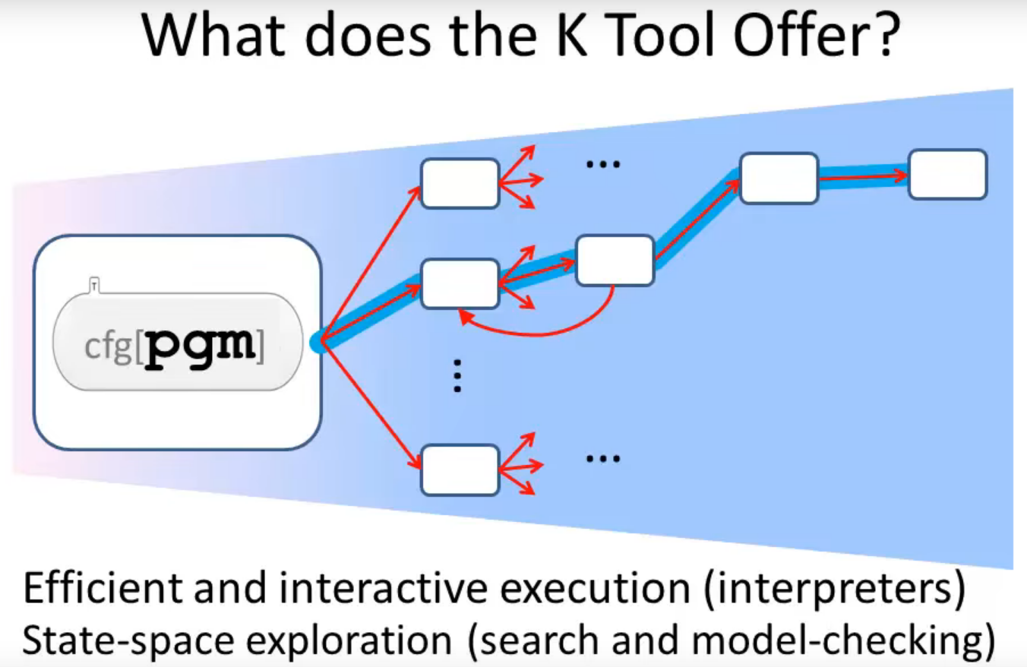
K framework

Slide 16
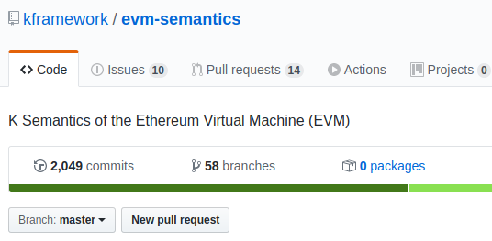
K framework as a solution?

Slide 17


Formal verification in XTZ

Slide 18
Michelson
Turing complete and formally specified, and can support a wide variety of different use cases.

Slide 19
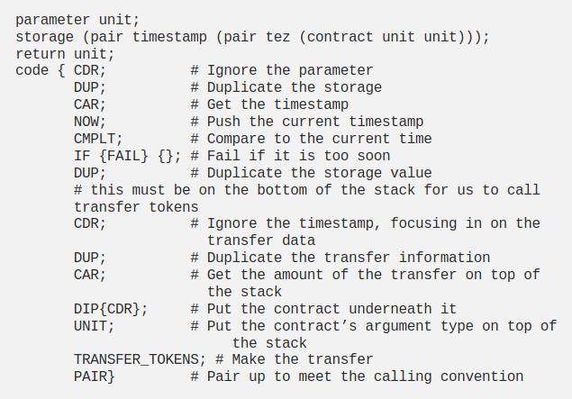
Formal verification - (not easy, maybe easier?) - Michelson in Tezos

Slide 20
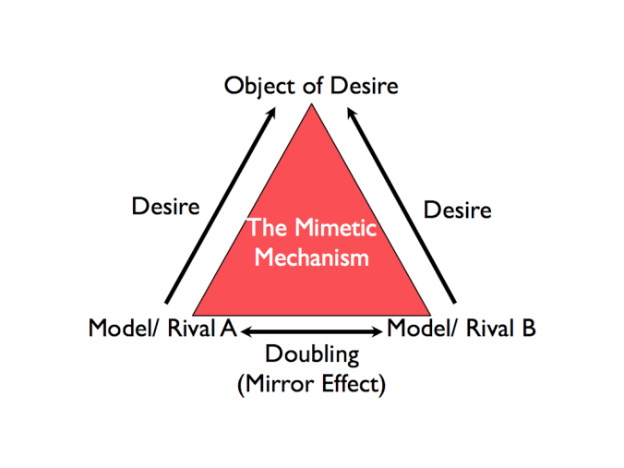
Psychology - Mimetic theory

Slide 21
Let’s conclude third wave
Gig economy
Deindustrialization
Dopamine economy
Daily life gamification
Political correctness
Attention economy
Algocracy
The end of offline, offline becoming the new luxury
Psychology
Virtual > Reality

Slide 22
IT systems from third wave will impact on psychology of every human beings, how we meet, how we communicate, WHY we communicate, how we think, WHY we think etc. etc.

Slide 23
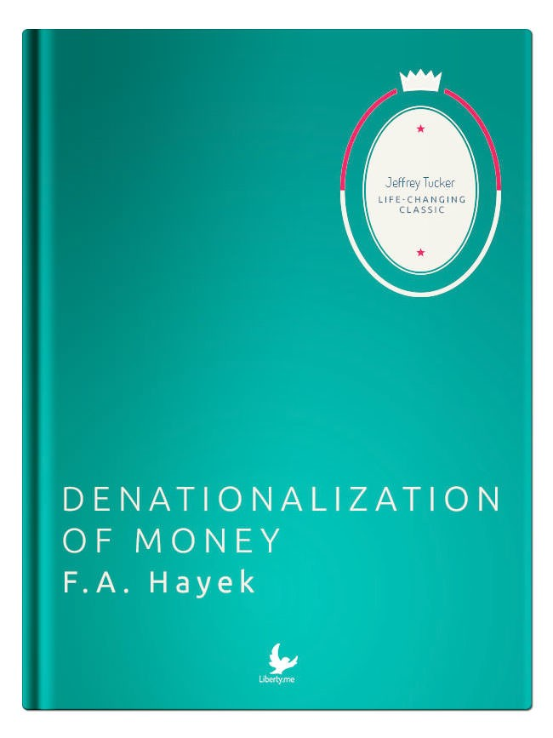
The Denationalization of Money

Slide 24
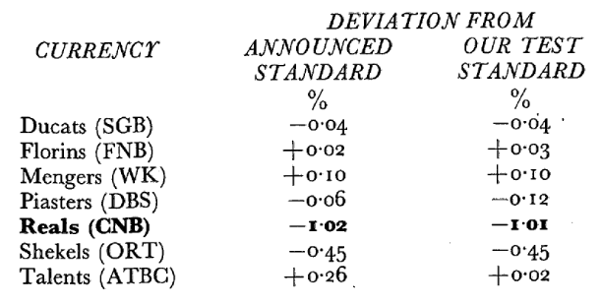
Return of the city-state
Nation-states came late to history, and there is plenty of evidence to suggest they won’t make it to the end of the century.

Slide 25
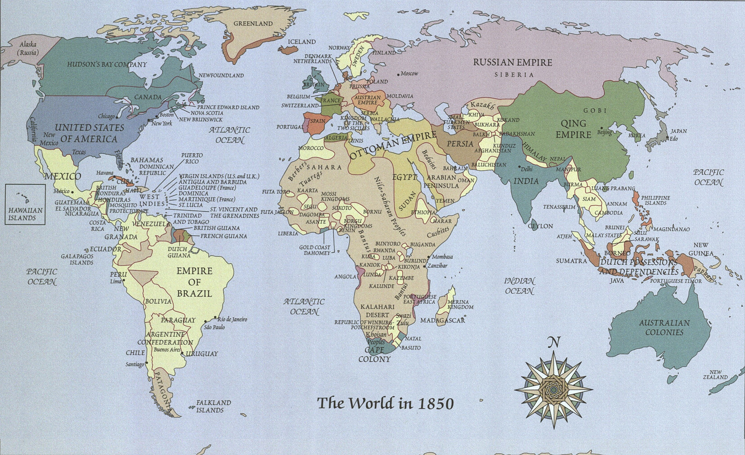

Slide 26

The end of democracy

Slide 27
“People don't have ideas. Ideas have people.” — Carl Jung

Slide 28
Smart contracts =? Government
“bonds of words are too weak to bridle men’s ambition, avarice, anger, and other passions, without the fear of some coercive power” (Leviathan, p. 69).

Slide 29
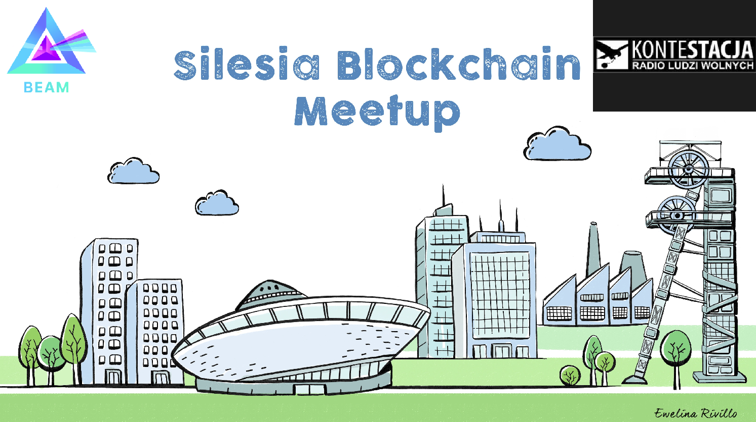
Silesia Blockchain Meetup

Slide 30
Thank you for attention, for invitation!
Any questions?!
Feedback and hints are welcome!
Fast contact with me: https://tlk.io/kbif

